Slide 1
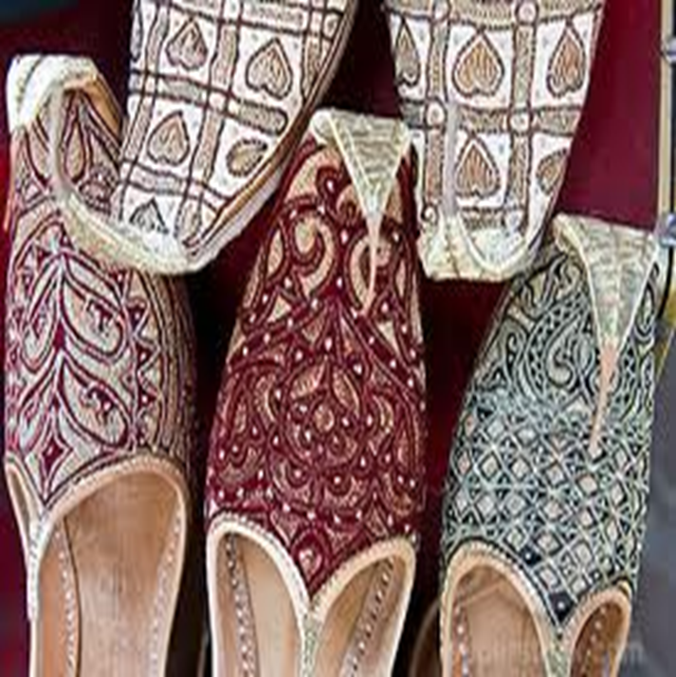
Lesson 7_part 2: الدرس السابع
Objectives:
Review
The morning greeting
Asking about well being
Arabic alphabet: two way connectors continue
Practice
Summary
Welcome to Arabic Level I by Kurzban

Slide 2
Do Now
How do you say? Write them in Arabic or transliteration
1
2
3
4
5
6
7
8
9
10

Slide 3
Alphabet: Going back to Shadda & Sukun

Slide 4
Lesson 7 Part 2: Review from last class
Copy the following words down on a ruled sheet of paper. Do you recognize these letters and their vowels?
شَ+ر + ا + ر =
سَ + رِ + ي + ر =
يَ + ا + س + ي + ن =
رِ + ي + ش =
يُ + شِ + ي + ر =

Slide 5
Connect the following letters to form words: خ ج ح
١} جَ + ا + ر + و + ر =
٢} رِ + ح + ا + ب =
٣} سِ + نْ + جَ + ا + ب =
٤} شَ + خِ + ي + ر=
٥} خَ + سِ + ي + س=

Slide 6
Lesson 7: Homework: Copy down these letters and connect them to form words including vowels and transliteration.
خ+تَ+ا+م=
حِ+ي+و+ا+ر=
زَ+ت+ج+ا+ن=
تُ+و+س+ي=
شَ+رْ+شَ+بِ+ي=

Slide 7
Lesson 7:
The morning greeting has the same function as its English counterpart. You may respond to this greetings, using the same phrase or another one which differs only in the second word.
& its response:
صَباَحُ الخَير

Slide 8
Morning Greeting
صَباَحُ النور

Slide 9
Asking about Well -Being
Usually when two people greet each other, they also ask about each other’s well-being.
How are you doing? Which letters do you recognize?
كَيفَ الحال؟

Slide 10
Asking about Well-Being
The culturally appropriate response is a positive one. That is, one is not expected to complain even if one is not faring well.
الحَمدُ لله بِخَيْر
It literally means” Thank God, I’m well”

Slide 11
Summary
Identify the letters that we have covered during this lesson by circling them:
حضرتك لطيفة. You are very kind
انا اسفة Sorry
شكرآ جزيلآ Thanks a lot
بخير، الحمد لله. وكيف أنت؟ Fine, and you?

Slide 12
Review
Review
Make your flash card for this lesson
Questions????

Slide 13
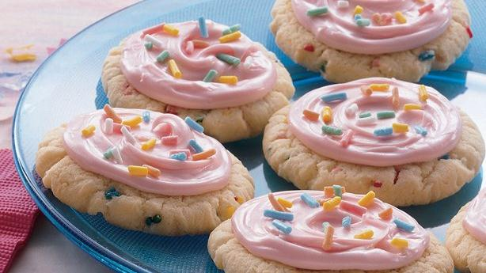
Cookies Today

Slide 14
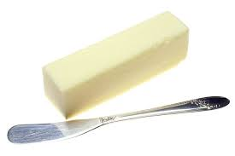
Ingredients
زبدة

Slide 15
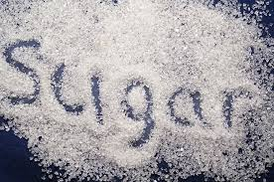
Ingredients
سكر

Slide 16
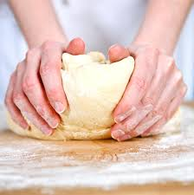
Ingredients
كعكة العجين

Slide 17
Ingredients
الرشات السكر

